Slide 1
Ted Analysis
Network Spatial Analysis

Slide 2
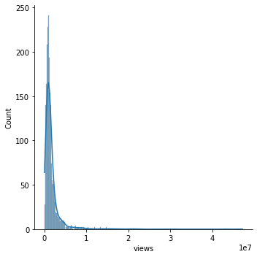
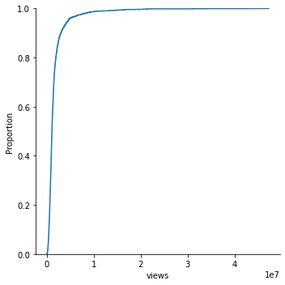
Views Distribution

Slide 3
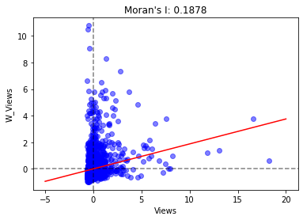
Correlation Analysis: Moran’s I
Converting the network into spatial adjacency matrix
Wij = 1 if connected by edge
The global metrics, Moran’s I shows a positive weak spatial correlation
Randomness hypothesis:
statistically significant
Expected value E(I) | Variance VAR(I) | Z score
-3.9231e-03 | 8.6938e-05 | 20.1828

Slide 4
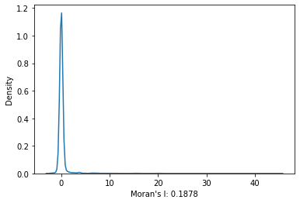
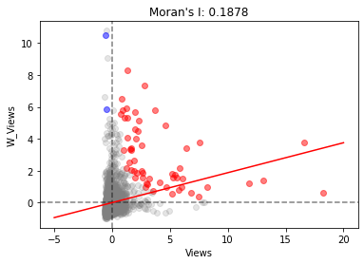
Clustering Analysis: LISA
Title | LISA | E(Ii) | VAR(Ii) | Z Score
Do schools kill creativity? | 9.6962 | -0.0004 | 0.9446 | 9.9771
Averting the climate crisis | -0.1395 | -0.0004 | 0.9582 | -0.1421
Simplicity sells | -0.0015 | -0.0004 | 0.9582 | -0.0011
Greening the ghetto | 0.0001 | -0.0004 | 0.9582 | 0.0005
The best stats you've ever seen | 0.3454 | -0.0004 | 0.9576 | 0.3533
By computing LISA, it provides the clustering effect among the ted talks
Using a 95 percent confidence level, red points are the ted talks with high LISA and blue points are the ted talks with low LISA.
Notes:
http://ceadserv1.nku.edu/longa//geomed/ppa/doc/LocalI/LocalI.htm

Slide 5
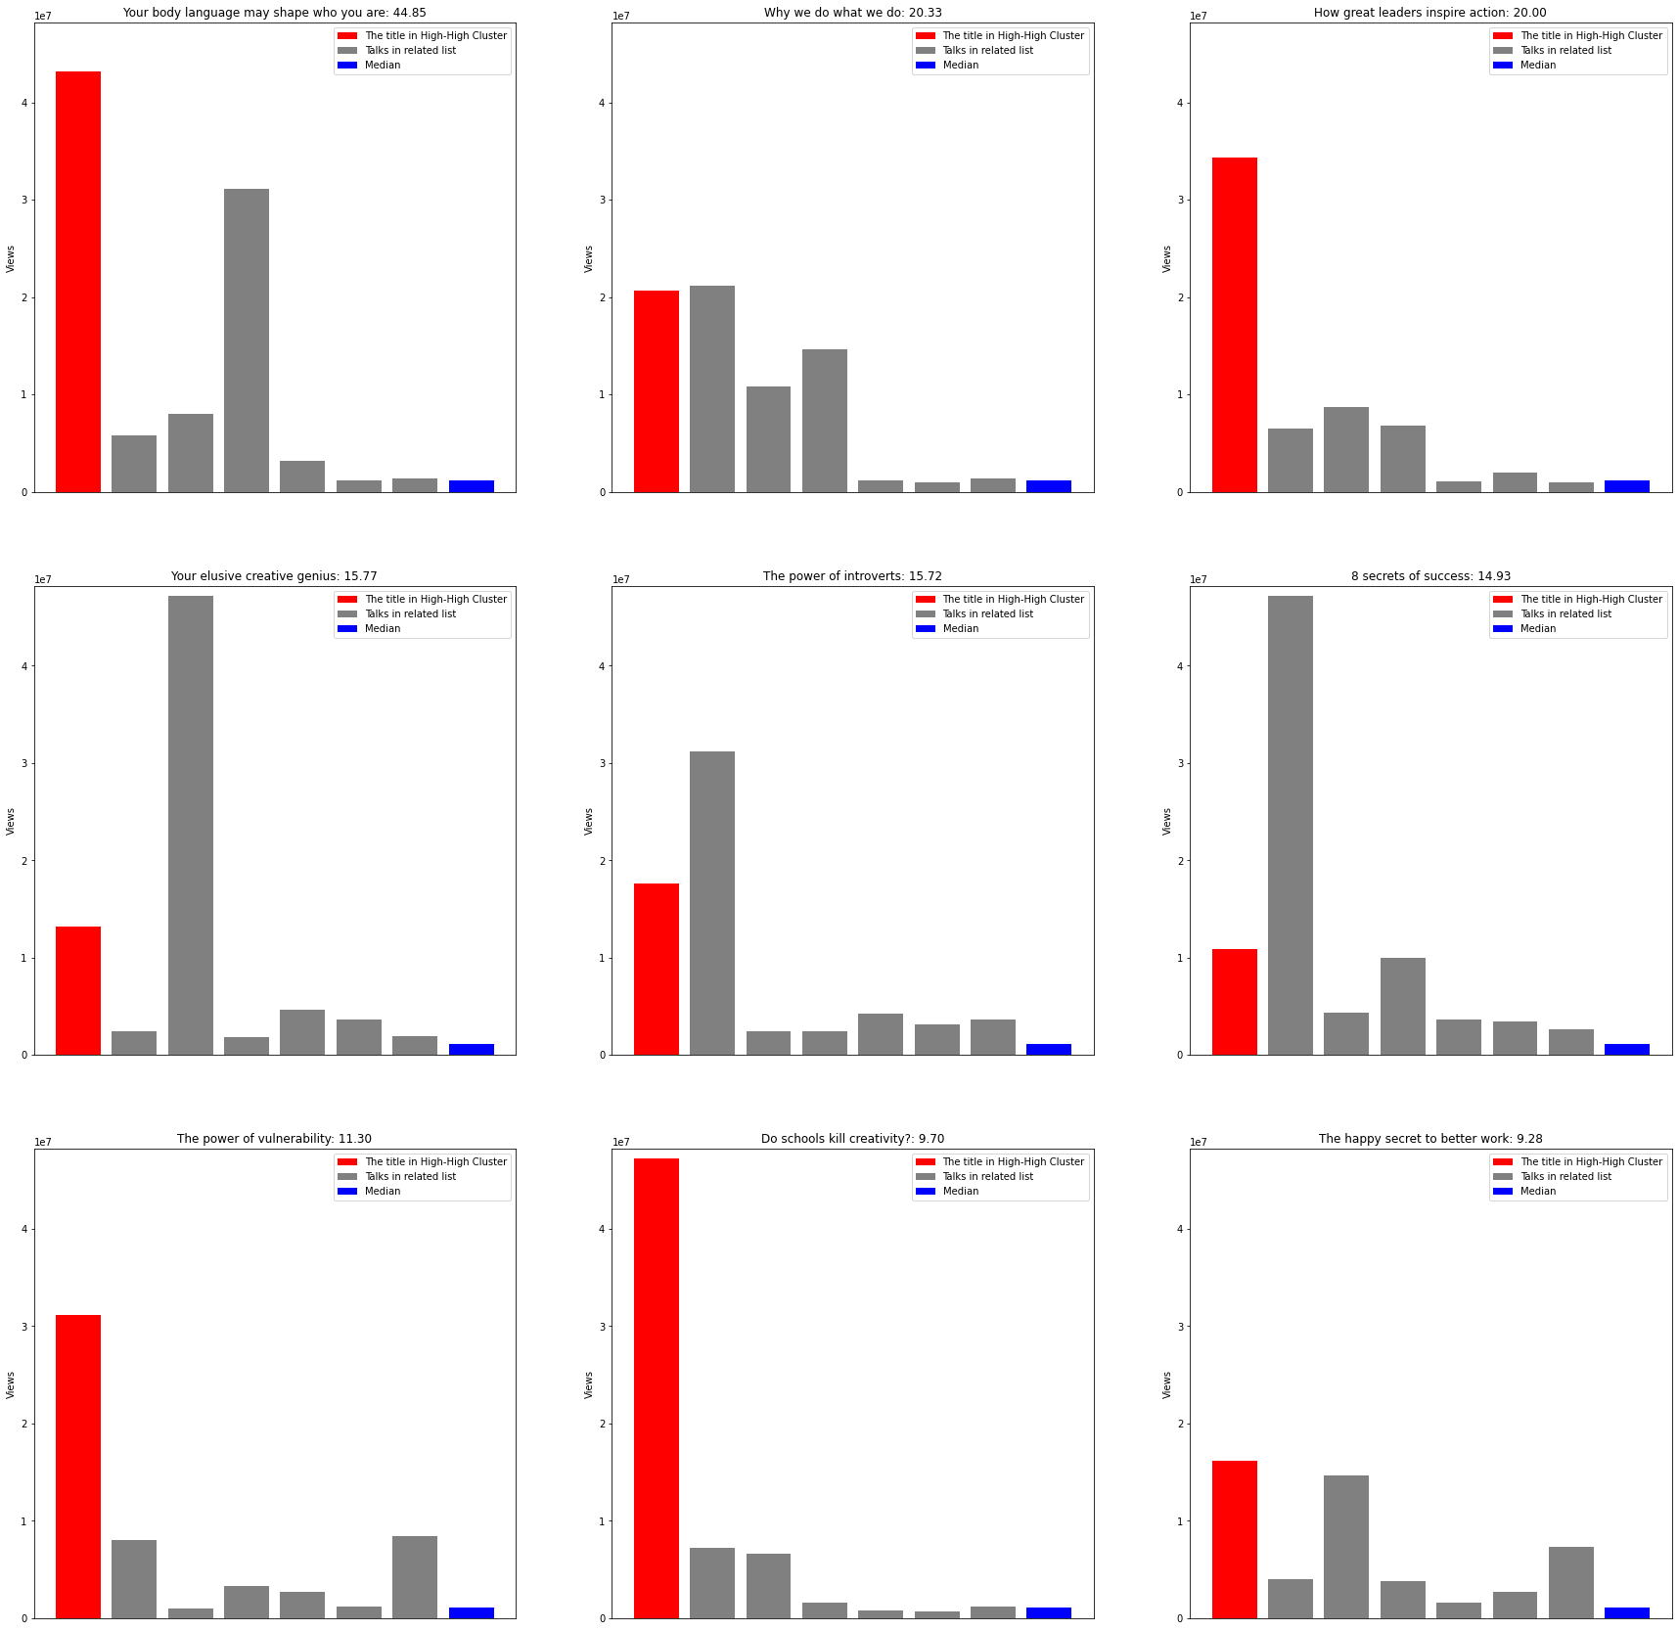
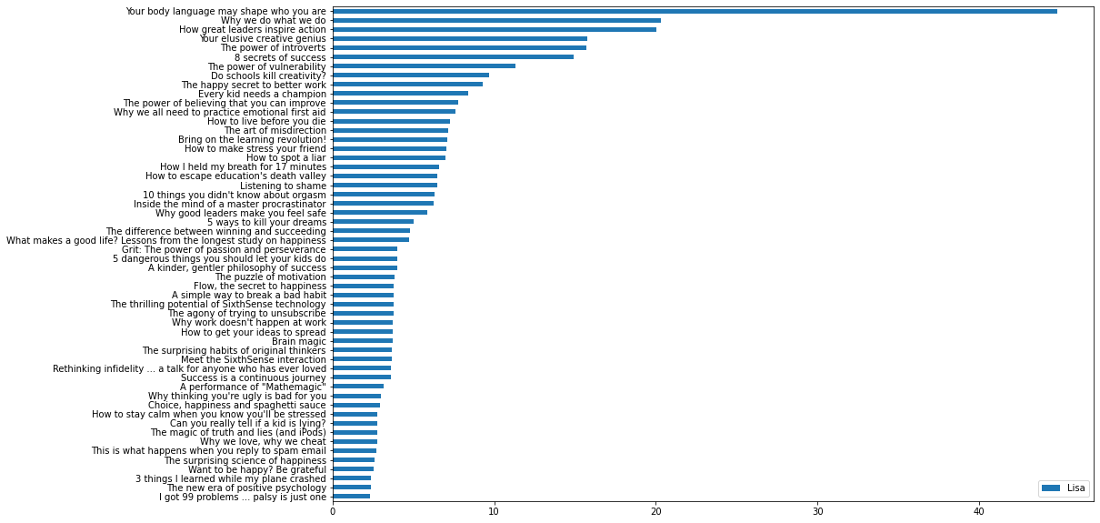
Ted Talks in the High-High Cluster
LISA of Ted Talks in High-High Cluster
Red: High LISA Talk | Gray: Related Talks | Blue: Median

Slide 6
Conclusion
The ted talks generally exhibits a weak positive correlation in the related lists.
From the High-High cluster, the local spatial relationship can be clearly observed.

